Slide 1
DSA CA-2 PROJECT
Music
Player
Presented by
Rajveer
Vadnal
BTech CSE - (AI & ML)
26070725501
3rd Semester
Musiclab Playlist Manager
A doubly linked list in C
22 October 2026
01
Notes:
Source: DSA_Report_Updated.pdf, p. 1. Source version f162a82a. Visuals are original figures/screenshots from the report. Screenshot details are cropped only for readability.

Slide 2
Introduction & problem
A local playlist manager
that makes C pointer
operations visible.
The core problem
Keep every link, endpoint
and selection valid when
song order changes.
Side A and Side B support playlist editing,
forward / backward navigation and playback.
The browser explains the
operations. The C backend
owns the playlist state.
A playlist must keep its song order and current selection consistent after every change. This project uses two playlists, Side A and Side B, to demonstrate how linked lists support editing and navigation in both directions.
02
Notes:
Source: DSA_Report_Updated.pdf, pp. 3–4. Source version f162a82a. Visuals are original figures/screenshots from the report. Screenshot details are cropped only for readability.

Slide 3
Project objectives
01
Implement the operations
Append, select, delete, navigate, reverse
and concatenate songs safely.
02
Explain pointer changes
Use the Simulation view to replay recorded
allocations, visits, link changes and frees.
03
Evaluate correctness
Test normal and boundary cases, reject invalid
input, and analyse time and space costs.
The main goal is to implement playlist operations safely and make their pointer changes understandable. The Simulation view replays recorded events, while normal and boundary tests check correctness and help explain the cost of each operation.
03
Notes:
Source: DSA_Report_Updated.pdf, p. 5. Source version f162a82a. Visuals are original figures/screenshots from the report. Screenshot details are cropped only for readability.

Slide 4
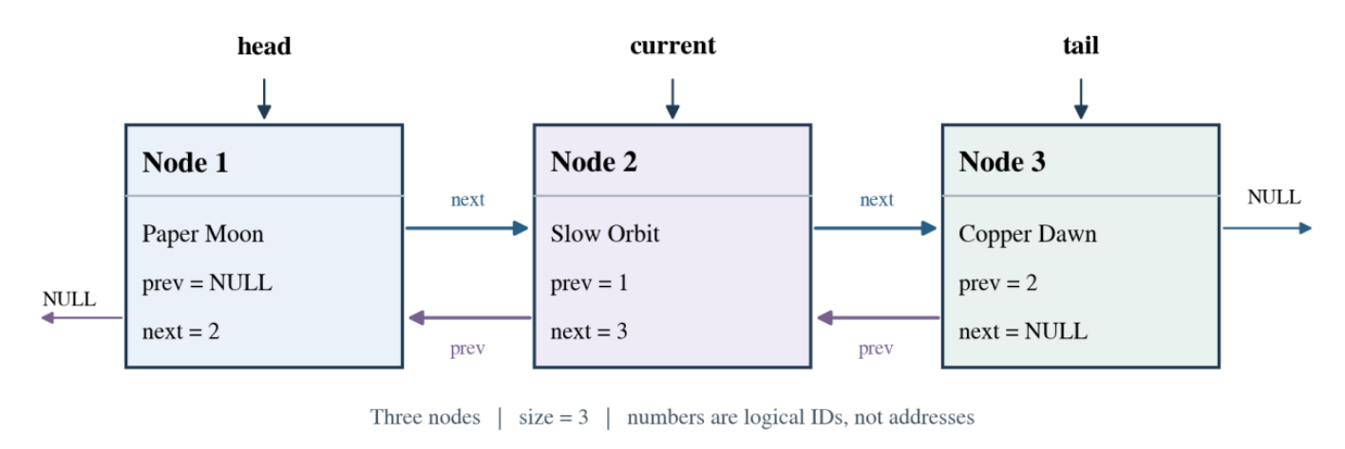
Doubly linked list design
Song node
Playlist
ID, title, artist, prev and next
head, tail, current, size
Each song is a node with links to the previous and next songs. The playlist stores its head, tail and current selection, so we can move in either direction and update the correct endpoints when songs change.
04
Notes:
Source: DSA_Report_Updated.pdf, p. 6, Figure 1. Source version f162a82a. Visuals are original figures/screenshots from the report. Screenshot details are cropped only for readability.

Slide 5
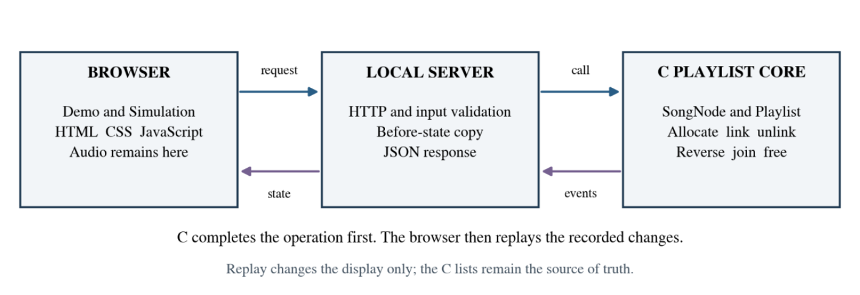
System architecture
Input validation happens before the C operation changes the playlist.
The browser sends a request to the local server, which validates the input before calling the C playlist core. C updates the list and returns state and recorded events, which the browser then displays and replays.
05
Notes:
Source: DSA_Report_Updated.pdf, p. 7, Figure 2. Source version f162a82a. Visuals are original figures/screenshots from the report. Screenshot details are cropped only for readability.

Slide 6
Operations & complexity
Operation | Core cost | Reason
Append | O(1) | Use the stored tail pointer
Next / Previous | O(1) | Follow an adjacent link
Select / Delete by ID | O(n) | Search before updating the node
Reverse | O(n) | Swap both links in every node
Merge B into A | O(1) | Join endpoints and clear B ownership
n = nodes in one playlist. N = total stored nodes. Storage is O(N).
State snapshots and JSON add O(N) work per request.
Append and adjacent navigation take constant time, while searching by ID and reversing require traversal. Merge joins endpoints in constant time at the core, but snapshots and JSON add linear work to the complete request.
06
Notes:
Source: DSA_Report_Updated.pdf, pp. 8–9, 16. Source version f162a82a. Visuals are original figures/screenshots from the report. Screenshot details are cropped only for readability.

Slide 7
Implementation
C backend
Browser interface
C11, GCC and Make
HTML, CSS and JavaScript
playlist.c manages nodes and links
api.c validates requests and returns state
server.c serves the local application
Demo: playback and playlist editing
Simulation: recorded C event replay
Audio remains in the browser
Limits: 200 songs total; 127 bytes per title or artist.
RUN LOCALLY
make then ./build/musiclab --port 8081
Open http://localhost:8081
The C backend manages playlist data and validates requests, while HTML, CSS and JavaScript provide the interface. Audio stays in the browser. We build the application with Make, start the local server and open it in a browser.
07
Notes:
Source: DSA_Report_Updated.pdf, p. 10. Source version f162a82a. Visuals are original figures/screenshots from the report. Screenshot details are cropped only for readability.

Slide 8
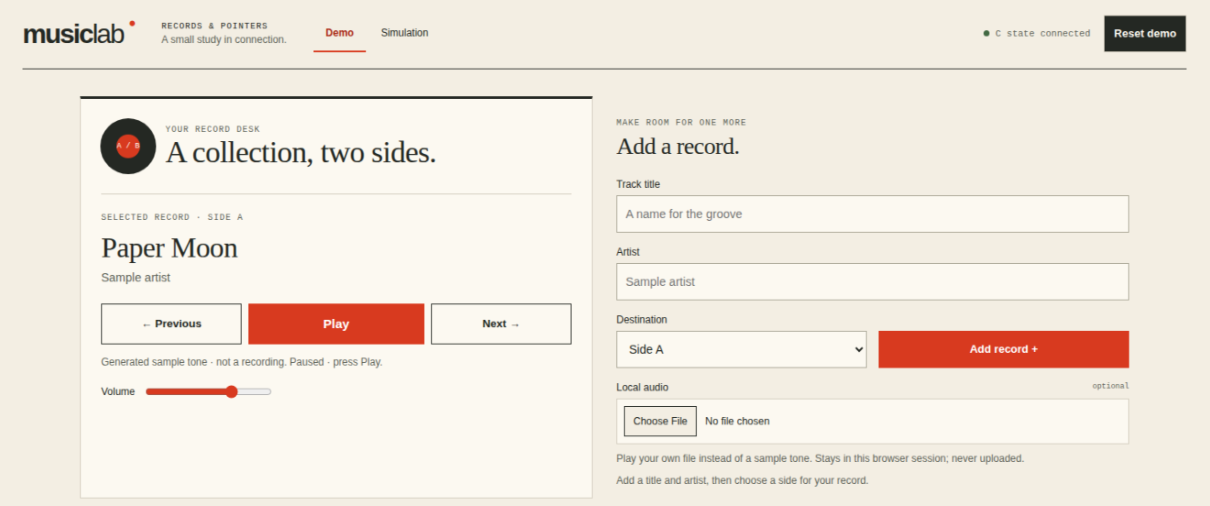
Demo view
Playback and playlist editing in one view
Player controls
Previous, Play and Next
with volume control.
Add a record
Title, artist and playlist;
optional local audio.
Sample melodies or local files play in the browser. C stores metadata and links.
This view lets us add songs, choose a playlist and use the playback controls. The browser plays sample melodies or local audio files, while the C backend maintains each song’s metadata and its position in the linked list.
08
Notes:
Source: DSA_Report_Updated.pdf, p. 13, Figure 3. Source version f162a82a. Visuals are original figures/screenshots from the report. Screenshot details are cropped only for readability.

Slide 9
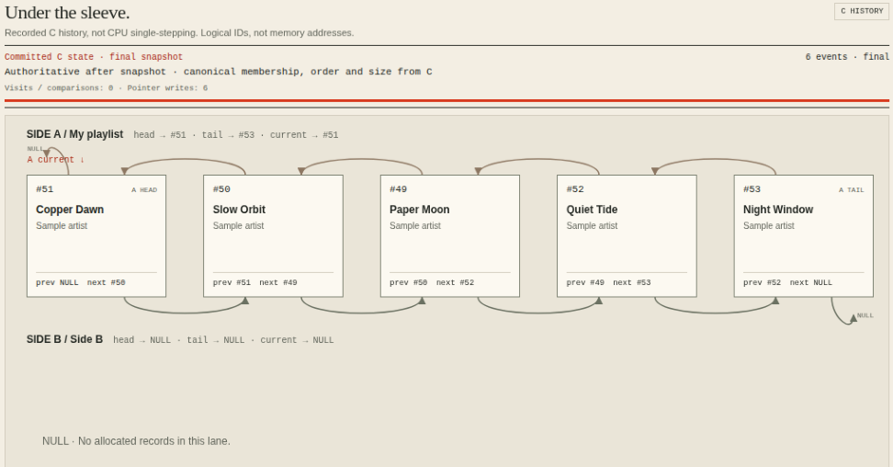
Testing & results
12
scenario groups
passed in the report
Native, trace, API
and frontend checks
also passed.
Guided run: five nodes in A, empty B
Known UI limitation: replay keyboard focus still needs a fix.
The report records twelve passing scenario groups, along with native, trace, API and frontend checks. These cover normal operations and boundary cases. A remaining limitation is keyboard focus during replay, which needs a fix and another browser test.
09
Notes:
Source: DSA_Report_Updated.pdf, pp. 11–12, 15, Figure 5. Source version f162a82a. Visuals are original figures/screenshots from the report. Screenshot details are cropped only for readability.

Slide 10
Conclusion & next step
The project connects playlist
behaviour with linked-list
operations and memory ownership.
Current scope
Next step
Local, temporary playlists. No accounts,
streaming or persistent catalogue.
Fix replay keyboard focus, then
repeat browser testing.
github.com/Rajveerx11/DSAProject
This project demonstrates how a doubly linked list supports playlist editing and navigation while keeping memory ownership clear. Its current scope is local, temporary playlists. The next step is to fix replay keyboard focus and repeat browser testing.
10
Notes:
Source: DSA_Report_Updated.pdf, pp. 4, 10, 12, 17–19. Source version f162a82a. Visuals are original figures/screenshots from the report. Screenshot details are cropped only for readability.

